Slide 1
CTF model for long reverberation Date：2022. 03. 08
Telecom Electroacoustics Audio (TEA) Lab
Presenter:
Anchi Yuan
Notes:
Hello everyone
I’m today’s presenter siang. I’m going to share some of my present work in source separation problem. My topic is comparative studies of source separation using semi-blind and blind source separation approaches.

Slide 2
Outline
Recursive estimation of CTF
Simulation settings
ATF estimation
Window lengths comparion
Source signal estimation
Future work

Slide 3
Recursive estimation of CTF

Slide 4
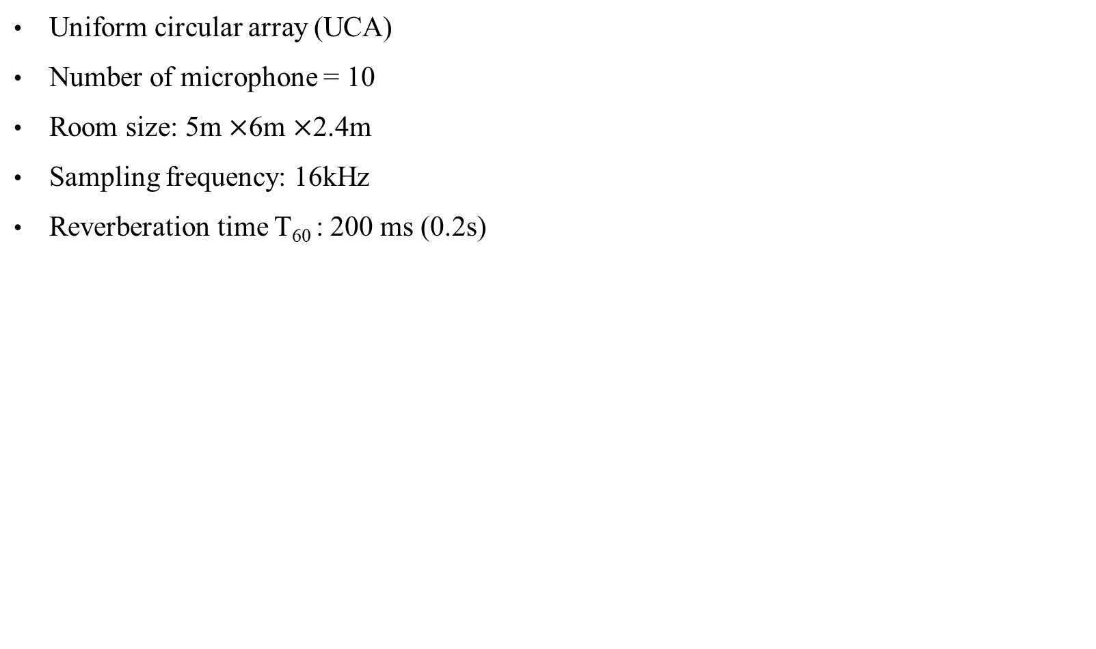
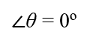
Simulation settings
Uniform circular array (UCA)
Number of microphone = 10
Room size: 5m $×$6m $×$2.4m
Sampling frequency: 16kHz
Reverberation time T₆₀ : 200 ms (0.2s)
….. mic6
mic4
mic3
Target source
(white noise)
R = 0.5m
mic2
mic1
3m
(1,3)
(4,3)
$∠$θ = 0º

Slide 5
ATF estimation

Slide 6
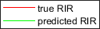
Window lengths comparison (1)
 | Window length = 32 | Window length = 64
CTF time domain plot comparison
Matching error | 0.6490 | 0.8044
Best one !!!

Slide 7
Window lengths comparison (2)
 | Window length = 128 | Window length = 256
CTF time domain plot comparison
Matching error | 0.5701 | 0.6354

Slide 8
Window lengths comparison (3)
 | Window length = 1024 | Window length = 2048
CTF time domain plot comparison
Matching error | 0.4583 | 0.2331

Slide 9

Source signal estimation
True source
Mic received

Slide 10
Window lengths comparison (4)
True source
 | Window length = 32 | Window length = 64
音檔
spectrogram

Slide 11
Window lengths comparison (5)
True source
 | Window length = 128 | Window length = 256
音檔
spectrogram

Slide 12
Window lengths comparison (6)
True source
 | Window length = 1024 | Window length = 2048
音檔
spectrogram

Slide 13
Future work
Debug
In this simulation , we use true source signal to initialize , however , in real application , we can’t obtain source signal , so we will try to predict source signal using recursive ATF method , then use it for initializing .

Slide 14



